Slide 1
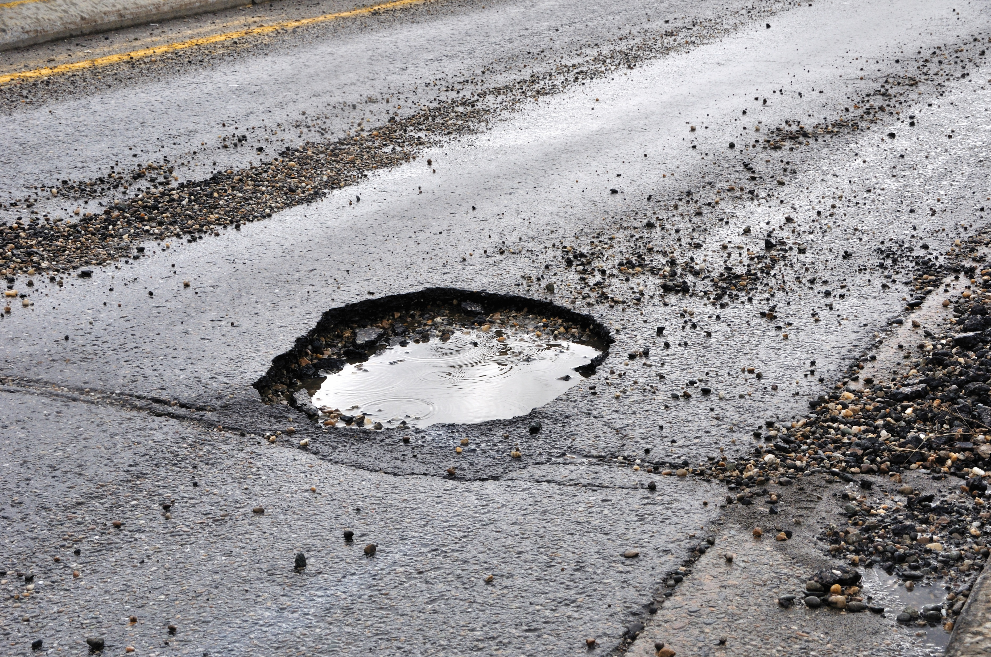

Slide 2
Detection and Repairing of Potholes
By Under the guidance of
Aadityanand Prof. Shubhangi Kharche
Ashish Sahu
Sahil Pandita
Varun Walimbe

Slide 3
INTRODUCTION
High amount of potholes =
Increase in Traffic : Mental and physical strain on humans
Damage to vehicles
Frequent repairing of road
High amount of accidents : 45000 in just one year!!

Slide 4
LITERATURE SURVEY
Pothole detection techniques already in use:
System based on Accelerometers - Disadvantage : vibration-based methods provides the wrong results
System based on 3D Laser Scanner - Disadvantage : High cost , requires very accurate equipment
System based on 2D image processing - Disadvantage : Cannot determine the magnitude of potholes for assessment
Inter vehicular communication-
Disadvantage: Deals with pothole of depth around 5 cm. No scope for correction.
Pothole Detection and warning system-
Disadvantage: a bot needed to survey the road first and then the data is store and transmitted. New pothole created left undetected.

Slide 5
PROPOSED SYSTEM
Our system will :
Detect potholes using CCTV camera
Update the numbers and locations to a database
A bot will be sent to the location
The bot will be automated to repair the pothole (of small size)
For bigger potholes the appropriate authorities will be messaged
Once the first wave is complete , any small pot hole generated can be repaired using the BOT

Slide 6
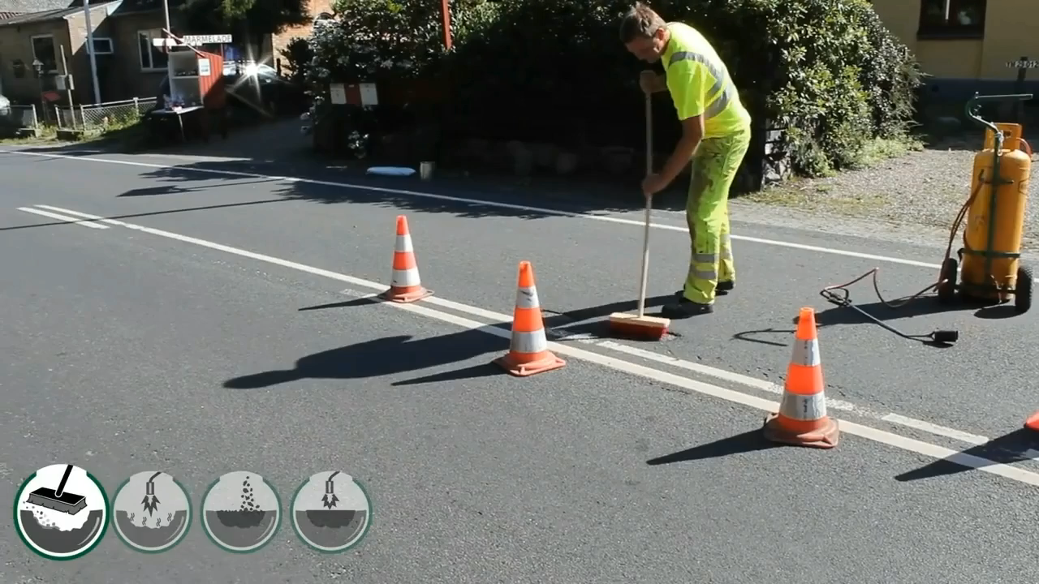
Cheapest and Fastest way to fill potholes:
sahil pandita

Slide 7
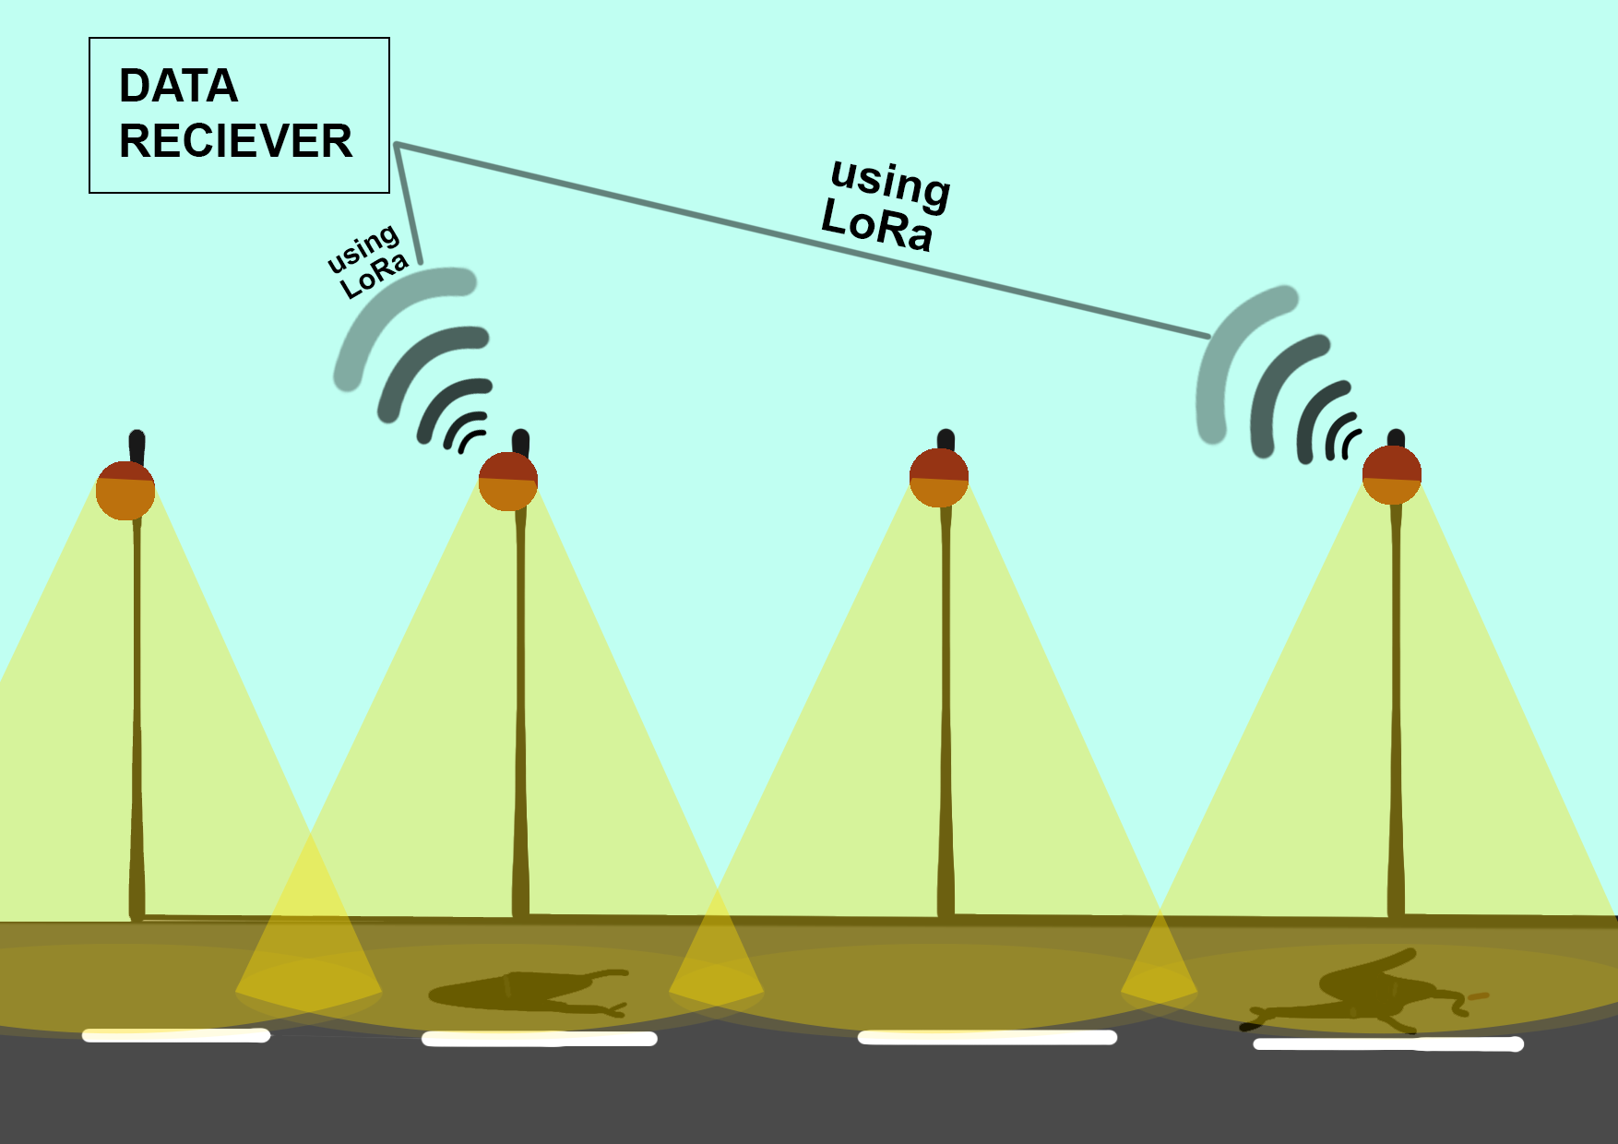

Slide 8
METHODOLOGY :
Image from CCTV
Image Processing program
Uploading information to the database
( UsingLoRa )
Location is sent to into the BOT
Uploading information to the database
( UsingLoRa )
Repairing of pothole
BOT is sent to the desired location

Slide 9
SYSTEM ARCHITECTURE
CCTV Footage
Server
Pothole Detection
database
Camera module
Raspberry pi
motors
Gps module
burner
Pothole repaired
Ultrasonic sensor
Servo motors
database

Slide 10
HARDWARE & SOFTWARE REQUIREMENT
Raspberry Pi
CCTV camera
Autonomous bot
Image Processing program : python
Autonomous bot software : python/embedded c
LoRa Module
Database

Slide 11
HARDWARE

Slide 12
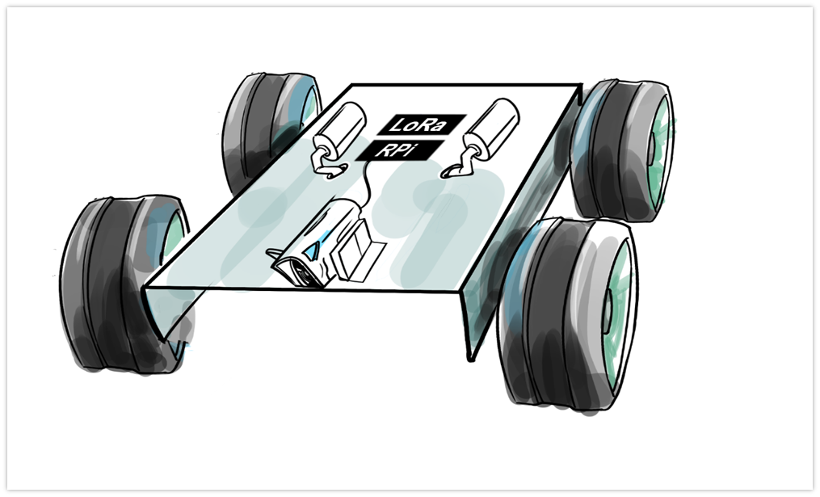
TOP OF THE BOT
Burner Module
Material container
It consists of :
Camera module
Raspberry Pi
Lora Module
Burner Module
Material container
Camera

Slide 13
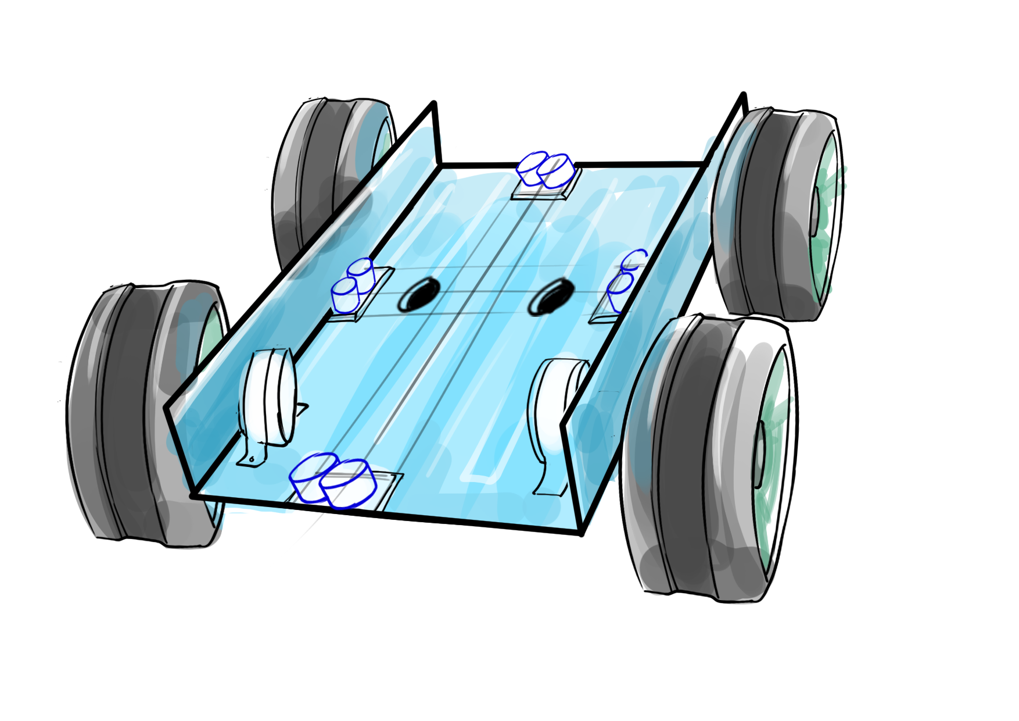
BOTTOM OF THE BOT
2 Nozzles
The back side consists of :
two nozzles , one for the burner and the other for material to fill the pothole.
UDM , to measure the depth of the pothole
Motors
UDM

Slide 14
SOFTWARE(MACHINE LEARNING)
Support Vector Machine : SVM is a machine learning algorithm that can perform classification as well as regression using boundary which is called hyperplane.
It is robust
It performs binary classification really well.
The result obtained by SVM is very promising .
It ignores all the outliers the data set

Slide 15
APPLICATIONS
Decrease the amount of potholes on the road : -Decreasing the number of accidents -Reduces the commuters anxiety -Reaching on time will be a thing then -Decreasing the expenditure on roads
Since we’re already using CCTV cameras -Accidents on the road can be identified -Prevention from road rage -Locating criminal bound vehicles
The data can be further used to analyse traffic patterns and lay new roads.
The data can be used to understand the wear of roads and plan a total renewal of roads.

Slide 16
CONCLUSION
In South Korea, there was a experiment to show the effectiveness of the earlier 2D road images and the current proposed system.
The bot uses thermosetting plastic, hence no consumption of fossil fuel for tar.
Therefore , we can assure you that the new method is highly effective than the previous system.

Slide 17
REFERENCES
Seung-Ki Ryu,1 Taehyeong Kim,1 and Young-Ro Kim2 1 Highway and Transportation Research Institute, Korea Institute of Civil Engineering and Building Technology, 283 Goyangdae-ro, Ilsanseo-gu, Goyang-si 411-712, Republic of Korea.
Artis Mednis, Girts Strazdins,Reinholds Zviedris ,Georgijs Kanonirs, Leo Selavo, Digital Signal Processing LaboratoryInstitute of Electronics and Computer Science ,14 Dzerbenes Str., Riga, LV 1006, Latvia, Faculty of Computing, University of Latvia.

